Slide 1



HR DATA ANALYSIS ASSESSMENT USING POWER BI & EXCEL
DATA ANALYSIS INTERNSHIP

Slide 2
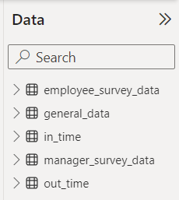
INTRODUCTION
Welcome to the inaugural data analysis report for PSYLIQ's Data Analysis Internship. This comprehensive document outlines the steps, methods, and actions employed to address assessment questions related to HR Data Analysis and provide valuable insights.
DATA OVERVIEW
Prior to addressing the assessment questions, it is imperative to comprehend the intricacies of our data, including its structure and contextual relevance.
The data is located across multiple Excel/CSV files.
The data comprising 4410 records organized across 24 attributes in a Tabular format.
Data focused on employees within the Company.

Slide 3
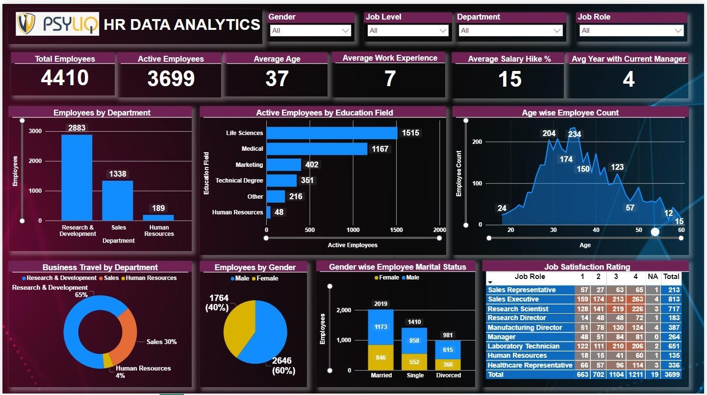
HR DATA ANALYSIS DASHBOARD

Slide 4
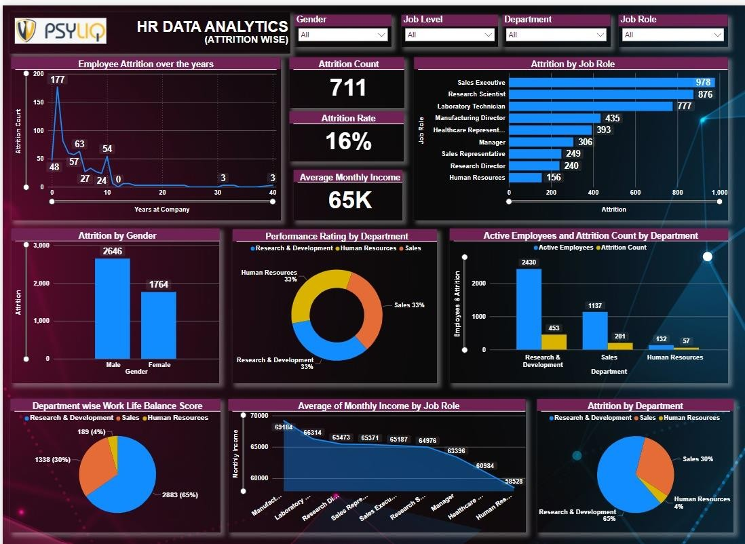

Slide 5

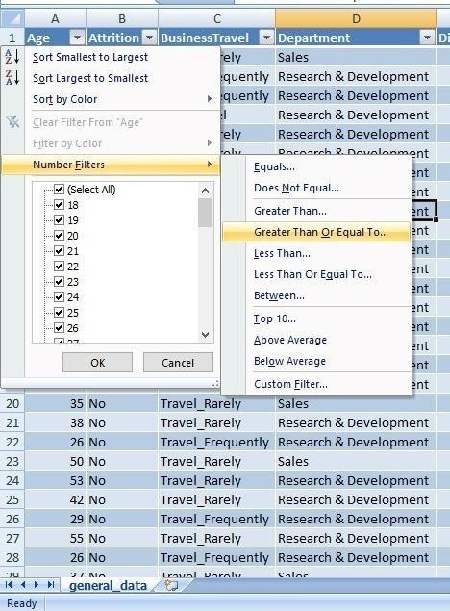
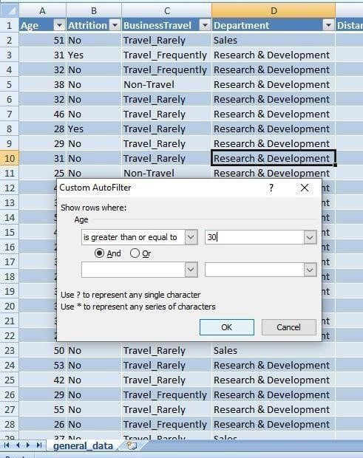
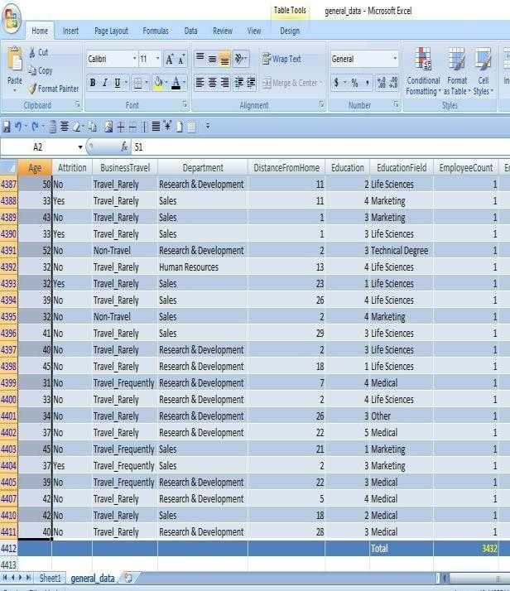
HR DATA ANALYSIS ASSESSMENT QUESTIONS
1. Using Excel, how would you filter the dataset to only show employees aged 30 and above?
A straightforward method involves converting the data range into a table. Utilizing the filter option beside the "Age" column, opt for number filters and choose Greater than or Equal to. This reveals 3432 employees aged 30 and above as shown below.
STEP 1
STEP 2
OUTPUT

Slide 6
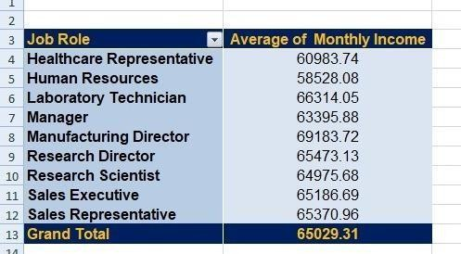
2. Create a pivot table to summarize the average Monthly Income by Job Role.
The Manufacturing Director has the highest average monthly income based on the summarized data.

Slide 7
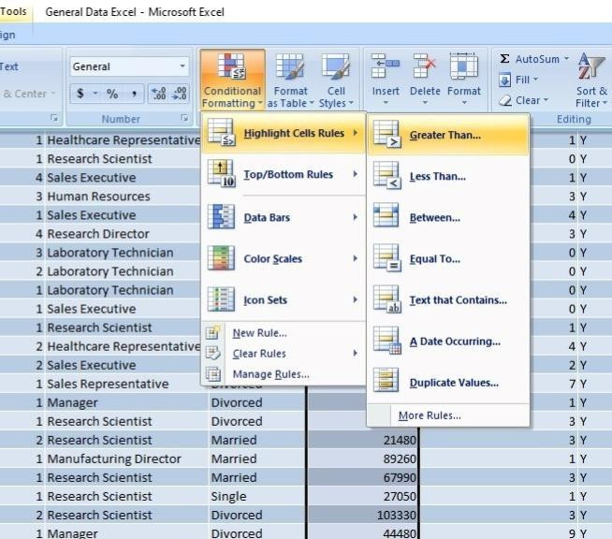
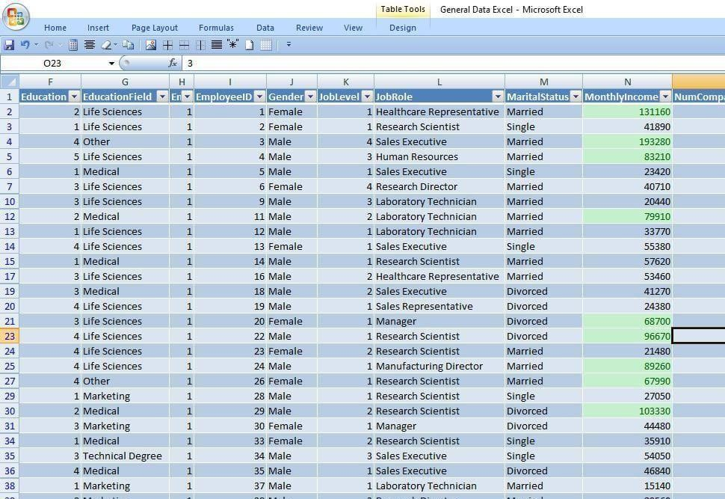
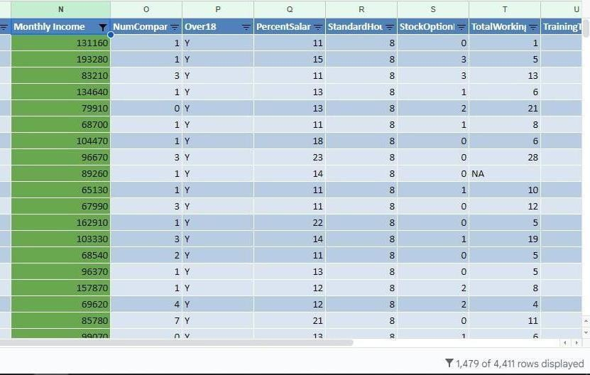
3. Apply conditional formatting to highlight employees with Monthly Income above the company's average income.
STEP 1
STEP 2
Result = 1479 Employees

Slide 8
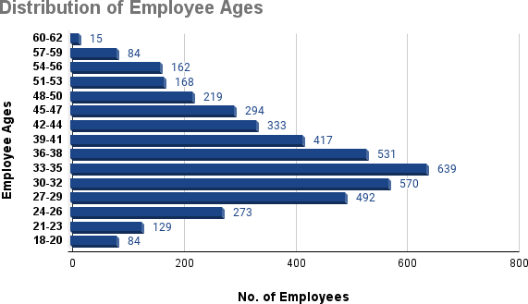
4. Create a bar chart in Excel to visualize the distribution of employee ages.

Slide 9
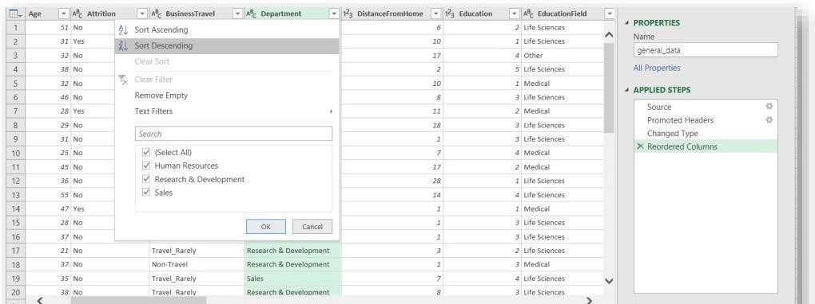
5. Identify and clean any missing or inconsistent data in the "Department" column.
After reviewing the Department column, it appears that the data in the column is consistent, clean, and does not contain any missing values.

Slide 10
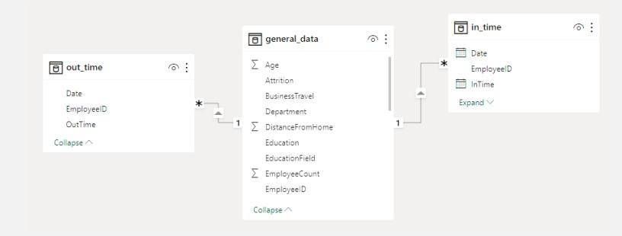
6. In Power BI, establish a relationship between the "EmployeeID" in the employee data and the "EmployeeID" in the time tracking data.
We connected "general_data," "in_time," and "out_time" files to Power BI and applied various transformations to the time tracking data. This involved adding headers, pivoting columns, and removing rows with "NA," which were assumed to represent holidays and weekends to exclude non- working days from the time tracking data.

Slide 11
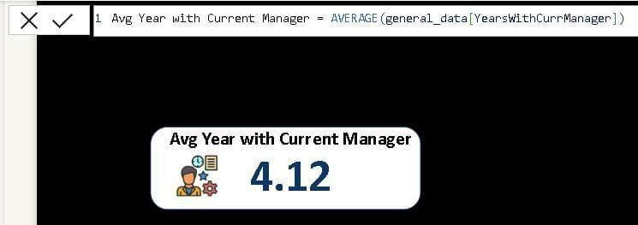
7. Using DAX, create a calculated column that calculates the average years an employee has
spent with their current manager.
DAX Formula –
Avg Year With Current Manager = AVERAGE(general_data[YearsWithCurrManager])

Slide 12
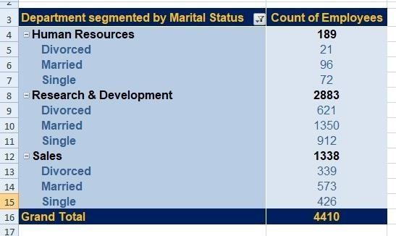
8. Using Excel, create a pivot table that displays the count of employees in each Marital Status category, segmented by Department.

Slide 13
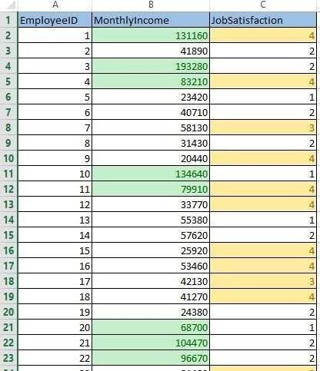
9. Apply conditional formatting to highlight employees with both above-average Monthly Income and above-average Job Satisfaction.
Initially, we utilized the "VLOOKUP" function to retrieve job satisfaction scores from a separate Excel file. Employing conditional formatting on the dataset revealed that 984 employees possess both above-average monthly income and above-average job satisfaction.

Slide 14
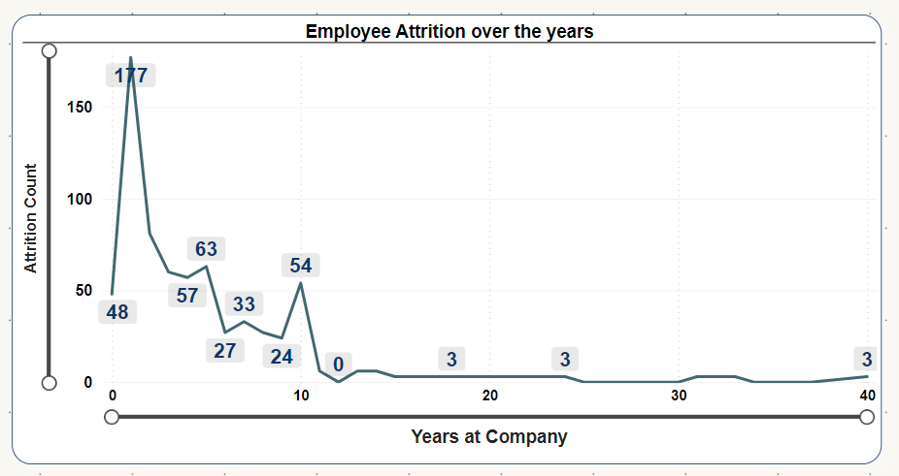
10. In Power BI, create a line chart that visualizes the trend of Employee Attrition over the years.

Slide 15
11. Describe how you would create star schema for this dataset, explaining the benefits of doing.
Creating a star schema for an HR dataset involves structuring the data into a central fact table containing key performance indicators, surrounded by dimension tables containing descriptive attributes.
Fact Table: general_data
This table serves as the fact table with a primary key "EmployeeID," which acts as a foreign key linking to various dimension tables.
Dimension Tables:
1. employee_survey_data
Contains descriptive attributes related to employee survey data.
2. manager_survey_data
Holds descriptive attributes related to manager survey data.
3. in_time
Includes descriptive attributes related to employees' login times.
4. out_time
Encompasses descriptive attributes related to employees' logout times.

Slide 16
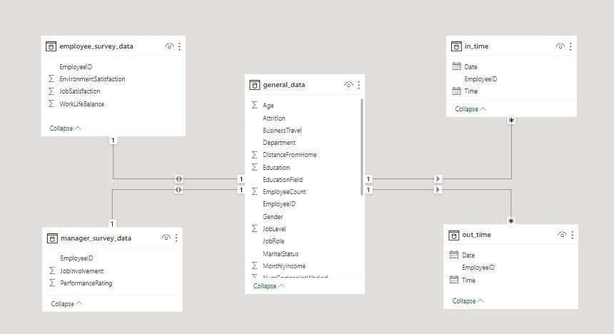
In this star schema:
The general_data table acts as the central hub, connecting to the dimension tables through the shared EmployeeID key. employee_survey_data, manager_survey_data, in_time, and out_time serve as dimension tables providing additional context to the central fact table.
The foreign key relationship between the fact table and dimension tables allows for efficient querying
and analysis, facilitating a comprehensive understanding of HR-related key performance indicators.

Slide 17
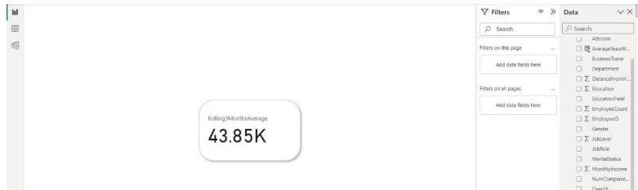
Benefits of Star Schema:
Simplicity and Understandability: Star schemas are user-friendly, making data interpretation and
querying straightforward.
Performance Improvement: Queries on star schemas are more efficient due to simple
relationships and precomputed aggregations in the fact table.
Scalability: Star schemas handle the addition of new dimensions or measures with minimal impact on performance, ensuring scalability.
Improved Query Performance: Query optimization is streamlined as star schemas simplify the
process of joining the fact table with dimension tables.
Enhanced Data Quality: Centralizing descriptive attributes in dimension tables improves data quality by facilitating easier maintenance and validation.
12. Using DAX, calculate the rolling 3-month average of Monthly Income for each employee.

Slide 18

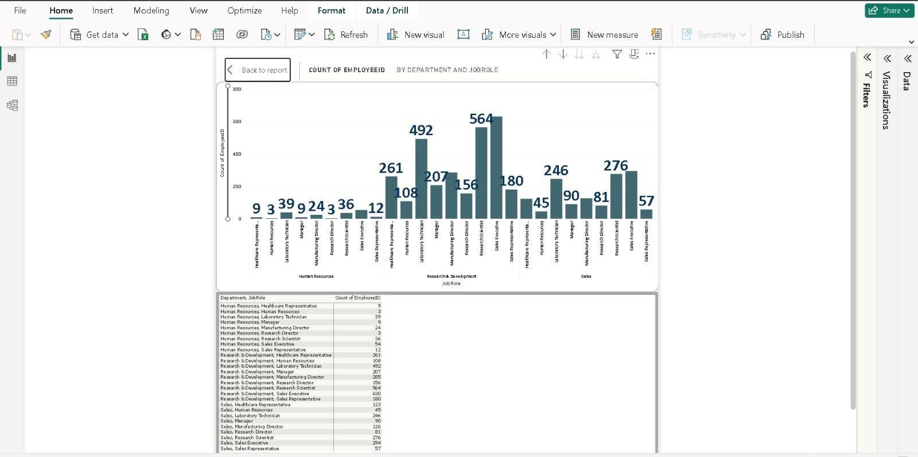
13. Create a hierarchy in Power BI that allows users to drill down from Department to Job Role
to further narrow their analysis.
Hierarchy for Department to Job Role
Drill down for Department
Drill down for Job Role
Hierarchy for Department to Job Role

Slide 19
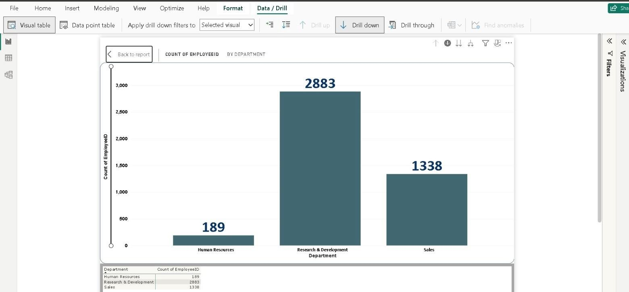
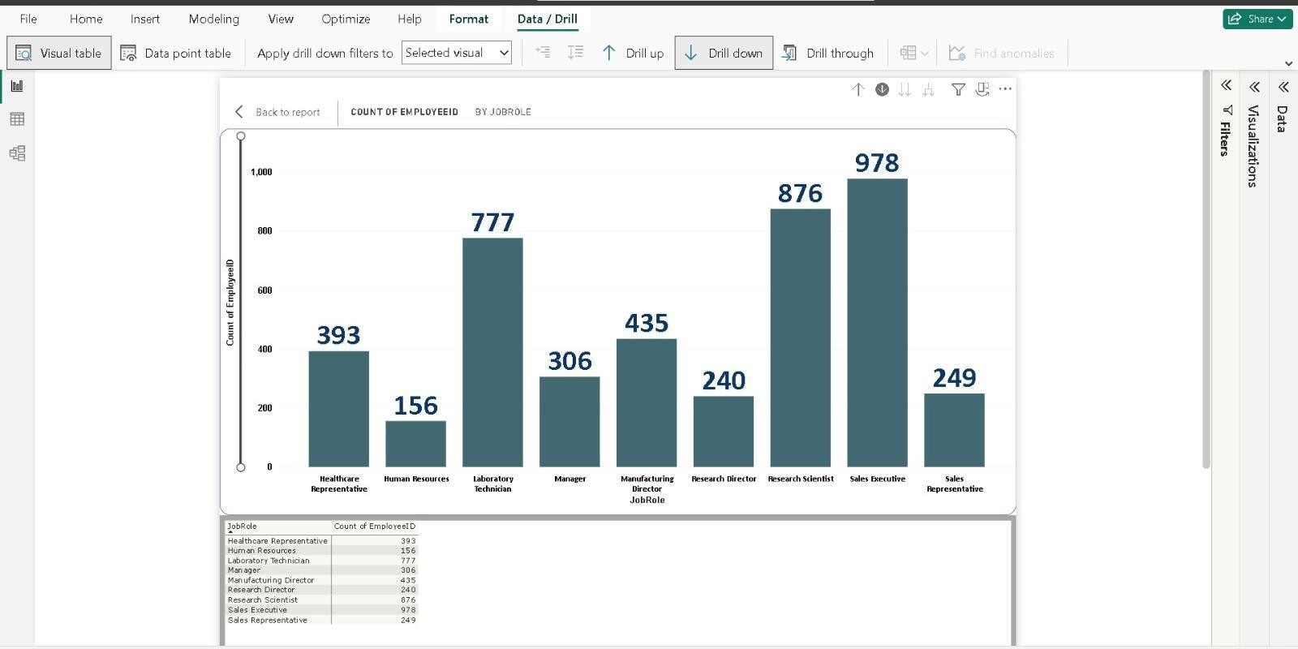
Drill down for Department
Drill down for Job Role

Slide 20
14. How can you set up parameterized queries in Power BI to allow users to filter data based on the Distance from Home column?
Power BI Parameterized Queries :
Create a Parameter:
Navigate to the "Home" tab in Power BI Desktop.
Click "Manage Parameters" in the External Data group.
Create a new parameter (e.g., "DistanceParameter") with a data type (e.g., Decimal Number) and set default values.
Modify the Query:
Go to the "Home" tab and select "Transform Data" to open Power Query Editor.
Locate the data-fetching query.
Modify the query to incorporate the parameter for filtering.
Apply the Parameter:
Close and apply changes in Power Query Editor.
Return to the main Power BI Desktop window.
Create a visual representation of your data.
Use the Parameter in Visual Filters:
Drag "Distance Parameter" onto the visual or use it in the filter pane.
Configure the visual to dynamically filter data based on the parameter.
Testing:
Interact with the parameter to dynamically filter data according to the specified condition.

Slide 21
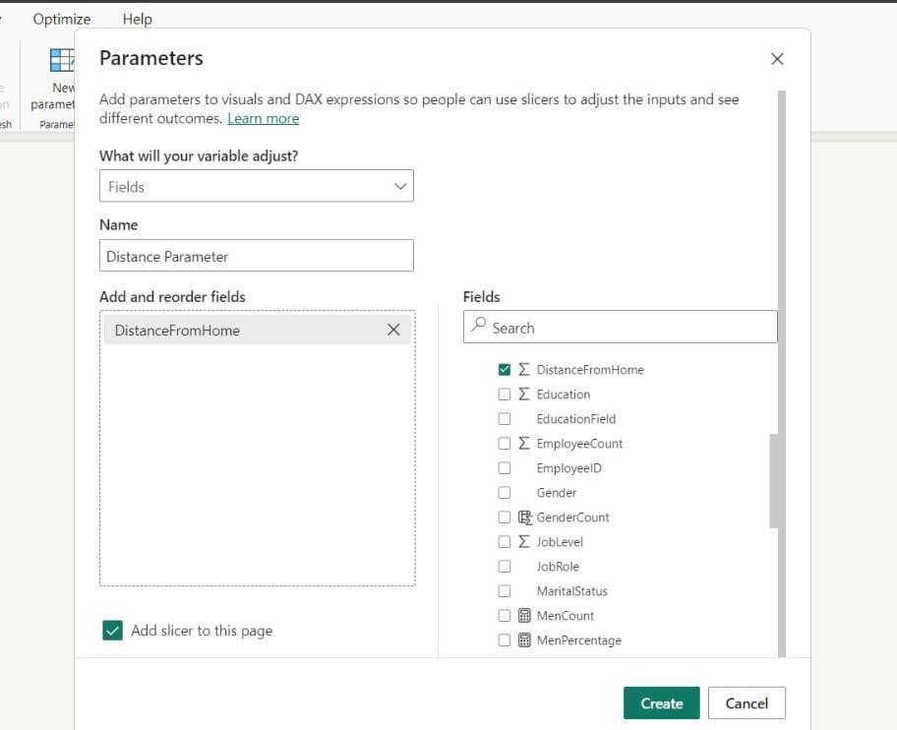
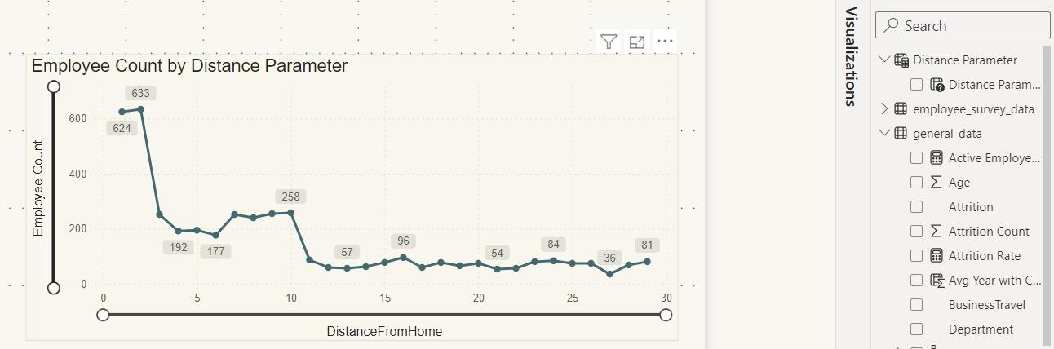
Creating a Parameter
Parameter in Visual Filter

Slide 22
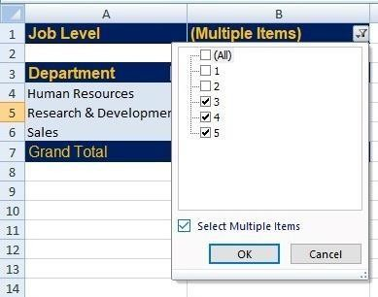
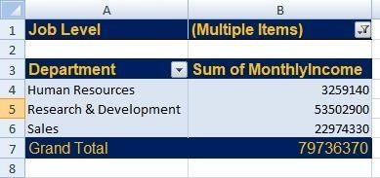
15. In Excel, calculate the total Monthly Income for each Department, considering only the employees with a Job Level greater than or equal to 3.
By configuring the pivot table with the appropriate Job Level filter, we can present the monthly
income data exclusively for employees at Job Level 3 or higher.
Applying a filter for Job Level 3 or above
OUTPUT

Slide 23
Explain how to perform a What-If analysis in Excel to understand the impact of a 10% increase in Percent Salary Hike on Monthly Income.
Performing a What-If analysis in Excel involves using the built-in tools, such as Data Tables or Goal Seek, to understand how changes in input values affect the results. Here's a step-by-step guide on how to conduct a What- If analysis to understand the effect of a 10% increase in Percent Salary Hike on Monthly Income:
Prepare Your Data:
Assume you have a table with columns like 'Employee ID', '% Salary Hike', and 'Monthly Income' in Excel.
Create a Data Table:
Select a cell in your worksheet.
Navigate to the "Data" tab on the Ribbon.
Click on "What-If Analysis" in the "Forecast" group, and choose "Data Table..." In the "Row input cell" box, select the cell containing the Percent Salary Hike.
Leave the "Column input cell" box blank or select a cell if applicable.
Click "OK."
Observe the Results:
Excel will generate a table illustrating the impact of various Percent Salary Hike values on Monthly Income. This table provides insights into how Monthly Income changes with different Percent Salary Hike values.
Define Scenarios:
Go to the "Data" tab on the Ribbon.
Click on "What-If Analysis" in the "Forecast" group and choose "Scenario Manager."
Click "Add" to create a new scenario.

Slide 24
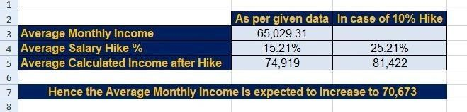
Enter a name for the scenario (e.g., "10% Increase").
Set the changing cells to the cell containing Percent Salary Hike and enter the new value (110% for a 10% increase).
Run the Scenario:
Return to "What-If Analysis" and choose "Scenario Manager".
Select the scenario you created and click "Show."
Excel will implement the scenario, adjusting the values in your worksheet based on the 10%
increase.
View the Impact:
Observe how Monthly Income changes with the 10% increase in Percent Salary Hike. This allows you
to assess the potential effects of the specified change on your data.

Slide 25
Verify if the data adheres to a predefined schema. What actions would you take if
youfind inconsistencies?
Yes, the data adheres to a predefined schema.
Here are some general steps and actions to verify and address inconsistencies:
Understand Schema: Know the predefined schema, including data types and constraints.
Use Validation Tools: Employ tools to automatically check data against the schema.
Manual Inspection: Manually review a sample for discrepancies.
Check Data Types and Constraints: Ensure data adheres to specified types and constraints.
Handle Missing Data: Decide on and implement a strategy for missing data.
Data Cleaning: Correct errors, remove duplicates, and standardize formats.
Communicate and Document: Inform stakeholders of issues and document actions taken.
Implement Ongoing Checks: Set up automated checks to maintain data quality.
Documentation: Maintain thorough documentation for future reference.
Iterative Process: Regularly update the schema and revisit data quality procedures.

Slide 26

THANK YOU

